Slide 1
TensorFlow Tutorial
CSCI-677
Jiyang Gao

Slide 2
Outline
Computational Graph
Operations
Placeholder, Tensor, Variable, Variable scope
Running the Graph
Gradients and Training
An Example
Using TensorFlow in Google Cloud

Slide 3
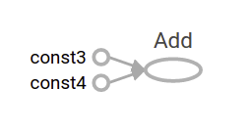
Computational Graph
A computational graph is a series of TensorFlow operations arranged into a graph of nodes.
Tensor
node1 = tf.constant(3.0, dtype=tf.float32)
node2 = tf.constant(4.0) # also tf.float32 implicitly
node3 = tf.add(node1, node2)
Operation

Slide 4
Tensor, Variables
A tensor is a generalization of vectors and matrices to potentially higher dimensions. Internally, TensorFlow represents tensors as n-dimensional arrays of base datatypes. The value of a tensor is immutable, which means that in the context of a single execution tensors only have a single value
A tf.Variable represents a tensor whose value can be changed by running ops on it. “When you train a model you use variables to hold and update parameters.”

Slide 5
Tensors, Variables, Placeholders
W = tf.Variable([.3], dtype=tf.float32)
b = tf.Variable([-.3], dtype=tf.float32)
x = tf.Constant(1.0, dtype=tf.float32)
y = W * x + b
W, b are Variables,
X is a tensor
Y is a tensor
W = tf.Variable([.3], dtype=tf.float32)
b = tf.Variable([-.3], dtype=tf.float32)
x = tf.placeholder(tf.float32)
linear_model = W * x + b
W, b are Variables,
X is a placeholder
Y is a tensor
A graph can be parameterized to accept external inputs, known as placeholders. A placeholder is a promise to provide a value later.

Slide 6
Tensors, Variables, Placeholders
Variable--Parameter;
Placeholder--Input;
Tensor--Feature (Output, intermediate results)

Slide 7
Variable Scopes
● Complicated TensorFlow models can have hundreds of variables.
○ tf.variable_scope() provides simple name-spacing to avoid clashes.
○ tf.get_variable() creates/accesses variables from within a variable scope.

Slide 8
Variable Scopes
Case 1: the scope is set for creating new variables, as evidenced by tf.get_variable_scope().reuse == False.
Case 2: the scope is set for reusing variables, as evidenced by tf.get_variable_scope().reuse == True.
with tf.variable_scope("foo"):
v = tf.get_variable("v", [1])
assert v.name == "foo/v:0"
with tf.variable_scope("foo"):
v = tf.get_variable("v", [1])
with tf.variable_scope("foo", reuse=True):
v1 = tf.get_variable("v", [1])
assert v1 is v

Slide 9
Operations
Basic math operations: tf.add, tf.mul, tf.sub, tf.argmax
Neural network operations: tf.nn.conv2d, tf.nn.softmax
Loss operations: tf.losses.mean_squared_error, tf.losses.hinge_loss
Array (Tensor) operations: tf.concat, tf.split, tf.reshape

Slide 10
Running the Computational Graph
Two phases:
Building the computational graph.
Running the computational graph. We must run the computational graph within a session, tf.Session
node1 = tf.constant(3.0, dtype=tf.float32)
node2 = tf.constant(4.0) # also tf.float32 implicitly
node3 = tf.add(node1, node2)
sess = tf.Session()
print("node3:", node3)
print("sess.run(node3):", sess.run(node3))

Slide 11
Gradients and Training
Once you define a loss in the graph,
○ tf.train.Optimizer creates an optimizer.
○ tf.train.Optimizer.minimize(loss, var_list) adds optimization operation to computation graph.
Different types of losses are available in TensorFlow: tf.train.GradientDescentOptimizer, tf.train.AdadeltaOptimizer, tf.train.AdagradOptimizer, tf.train.MomentumOptimizer, tf.train.AdamOptimizer, tf.train.RMSPropOptimizer

Slide 12
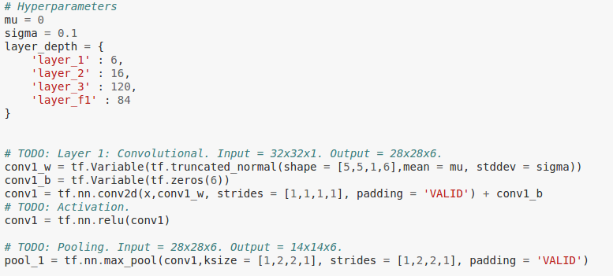
A network example

Slide 13
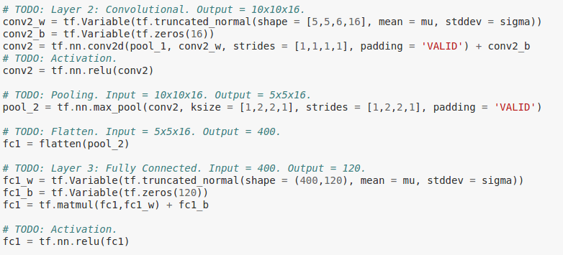
A network example

Slide 14
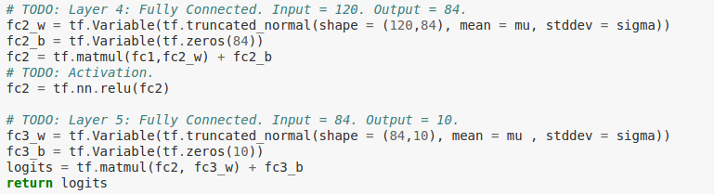
A network example

Slide 15
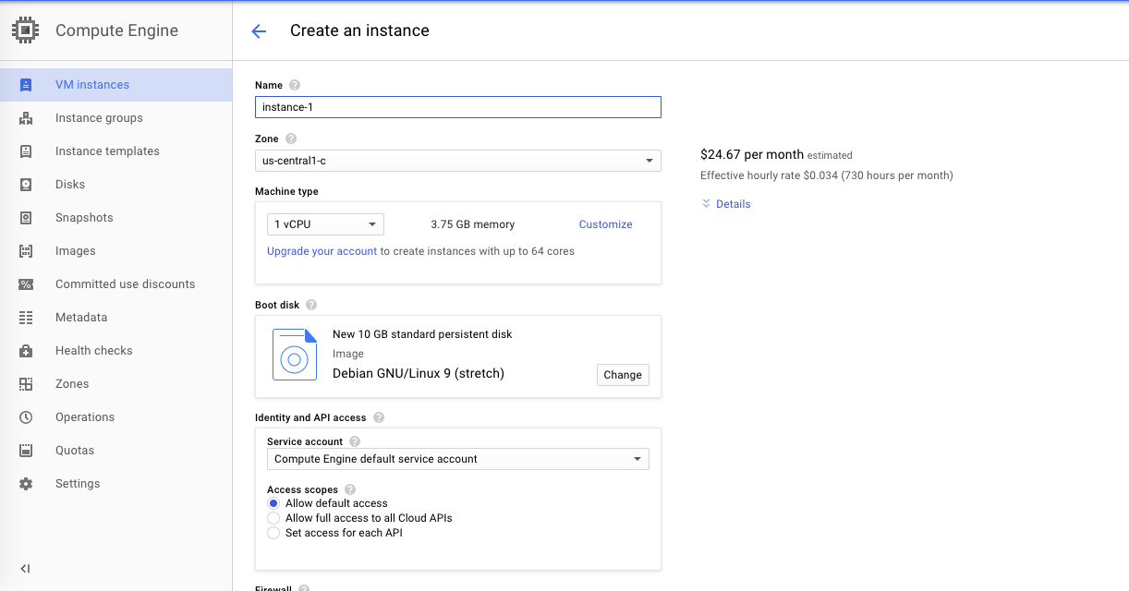
Using TensorFlow in Google Cloud
Create a VM instance, select the resource (CPU, GPU, Memory, Disk) you need and the operating system.

Slide 16
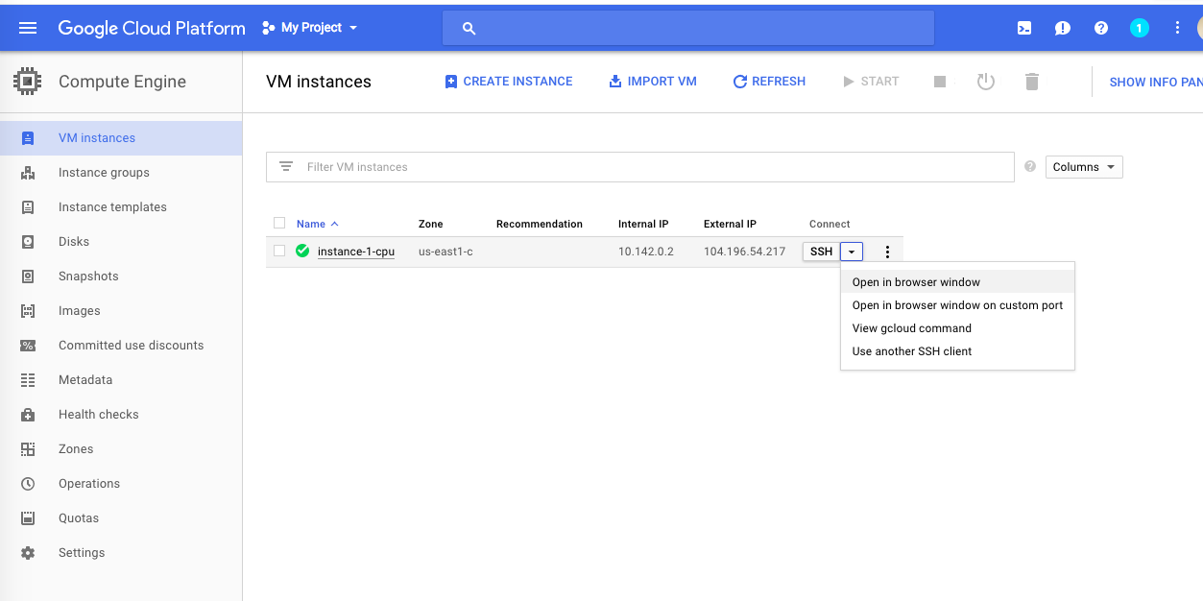
Using TensorFlow in Google Cloud
Connect to the instance via SSH

Slide 17
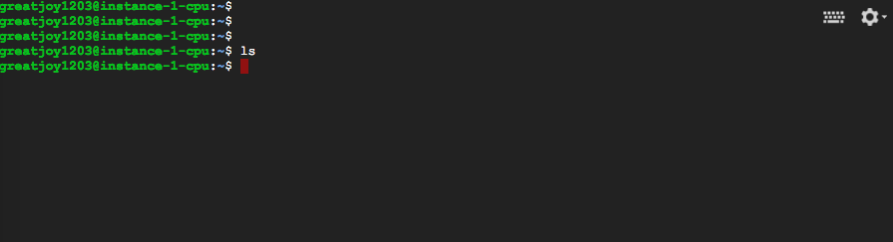
Using TensorFlow in Google Cloud
Install Tensorflow on it.
sudo apt-get update sudo apt-get -y upgrade \ && sudo apt-get install -y python-pip python-dev
sudo pip install tensorflow

